Slide 1
DEPARTMENT OF COMPUTER SCIENCE & ENGINEERING
BATCH 2024–2028 · PROJECT 09
IOT-BASED REAL-TIME INFRASTRUCTURE
Smart Parking System Using IoT
Automated vehicle detection, edge sensor processing, and live cloud slot monitoring.
ESP32 Wi-Fi Telemetry
Ultrasonic & IR Sensing
Live Cloud Dashboard
October 2026

Slide 2
CURRENT CHALLENGES
The Conventional Parking Dilemma
Manual hunting wastes urban space, time, and fuel.
Manual Search Time
Fuel & Emissions
Zero Remote Visibility
Human Dependency
Drivers spend extensive time searching without vacancy guidance.
Continuous roving inside lots increases fuel burn and exhaust fumes.
No centralized dashboard informs drivers before entering the lot.
Heavy reliance on parking attendants during peak congestion hours.
Core Impact: Over 30% of downtown traffic congestion is caused by drivers hunting for parking spots.
CRITICAL FRICTION

Slide 3

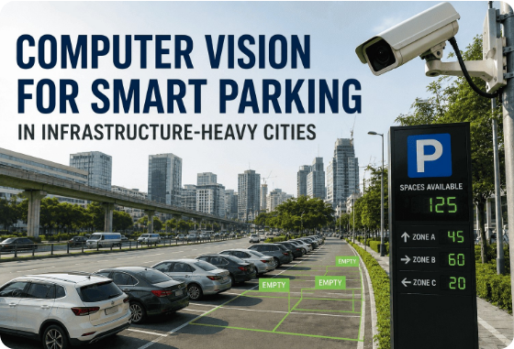



PROJECT INNOVATION
Proposed IoT Smart Parking Solution
Automated sensing, microcontroller logic, and real-time displays.
Per-Slot Automated Sensing
Infrared and ultrasonic sensors detect exact spot occupancy continuously.
ESP32 Edge Microcontroller
Processes digital input pins and determines real-time slot vacancy state.
Wi-Fi Cloud Telemetry
Syncs occupancy logs instantly to web dashboards and mobile frontends.
Dual Local & Remote Display
On-site LCD/LED indicators guide drivers directly at entry gates.

Slide 4
SYSTEM BLUEPRINT
5-Tier Architectural Model
Sensing Layer
IR Obstacle Sensors + HC-SR04 Ultrasonic modules mounted per slot (S1–S4).
TIER 01
Raw Proximity Signals
Processing Layer
ESP32 Dual-Core SoC: GPIO edge polling, debounce validation, and state classification.
TIER 02
Available / Occupied
Communication Layer
Onboard 802.11 b/g/n Wi-Fi sending lightweight MQTT packets and HTTP REST queries.
TIER 03
Wireless IP Pipeline
Cloud / Data Layer
ThingSpeak / Firebase Realtime DB / Blynk Cloud storage for live JSON slot status.
TIER 04
Realtime Database
User Interface Layer
Physical 16x2 I2C LCD + Red/Green LEDs for on-site drivers, Web UI for mobile drivers.
TIER 05
Visual Feedback

Slide 5
HARDWARE STACK
Component Specifications & Roles
Engineered for low-power consumption and high reliability.
ESP32 NodeMCU
IR & Ultrasonic
16x2 LCD / OLED
LEDs & Buzzer
CORE CONTROLLER
DETECTION SENSORS
GATEWAY DISPLAY
INDICATORS & ALERTS
Dual-core Xtensa 32-bit MCU with integrated 2.4 GHz Wi-Fi and Bluetooth BLE.
Infrared reflection and 40kHz sound waves detect car chassis presence accurately.
I2C wired screen displaying total free capacity and slot status at the lot entrance.
Green (Free) & Red (Occupied) per bay, plus audio buzzer for invalid parking alerts.
Operating Voltage: 5V DC (USB/External Regulator)
Current Draw: ~180mA
Pin Mapping: GPIO 12-15 (Sensors), GPIO 21/22 (I2C SDA/SCL)
Zero Pin Conflict

Slide 6
SENSOR PHYSICS
Vehicle Detection & Signal Processing
IR Obstacle Module
OPTICAL
HC-SR04 Ultrasonic
ACOUSTIC
Infrared emitter diode transmits an 850nm beam. When a vehicle enters the bay, the reflective body reflects the beam back into the photodiode receiver.
Transmits a 10µs pulse creating 40kHz ultrasound bursts. Time-of-flight (ToF) calculates the distance to the vehicle's bumper or roof.
Formula: Distance = (Time × 0.034 cm/µs) / 2
Threshold: Active LOW output (0V)
Range: 2 cm to 400 cm accuracy
Calibration: LM393 Potentiometer trimmer
Ideal for: Cost-effective indoor covered parking bays.
Ideal for: Outdoor spaces immune to ambient sunlight.

Slide 7

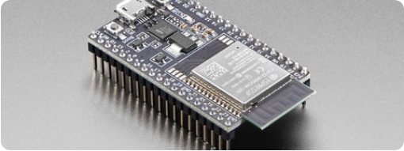
EDGE COMPUTING
Microcontroller Logic & Cloud Transmission
Real-time debounce, state comparison, and MQTT/HTTP publishing.
1. Continuous Pin Sampling
Reads digital input pins from sensors S1, S2, S3, S4 at 100ms intervals.
2. Debounce & Noise Filtering
Validates sensor state stability across 3 consecutive cycles to reject false triggers.
3. Local Actuation & I2C Update
Toggles GPIO LED status indicators and writes formatted slot count to LCD.
// Telemetry Payload Format
{
"lot_id": "SMVEC_P9",
"slots": {"S1": 1, "S2": 0, "S3": 1, "S4": 0},
"total_free": 2
}
4. Asynchronous Cloud Uplink
Dispatches JSON payload via Wi-Fi to Firebase Realtime DB and ThingSpeak channel.

Slide 8
WORKFLOW LIFECYCLE
End-to-End Operational Lifecycle
01
02
03
04
Vehicle Entry
Proximity Detect
ESP32 Interrupt
Slot Marked OCCUPIED
Vehicle drives into assigned slot bay S1–S4.
IR/Ultrasonic sensor changes logic state.
Microcontroller reads state change immediately.
Local bay LED illuminates RED instantly.
05
06
07
08
Wi-Fi Packet Push
Cloud DB Sync
Dashboard Refresh
Departure Reset
ESP32 transmits status over secure Wi-Fi.
Cloud database updates live slot status table.
Web & entrance LCD update available count.
Vehicle exits and slot resets to AVAILABLE.

Slide 9

PROTOTYPE SCHEMATIC
4-Slot Parking Matrix & Live Status
Slot S3
OCCUPIED
Slot S4
AVAILABLE
ESP32
Central Controller Hub
Continuous polling of 4 GPIO input lines. Multiplexed transmission to local 16x2 LCD and Wi-Fi IoT Gateway.
Vehicle Detected
Empty Slot
Slot S1
OCCUPIED
Slot S2
AVAILABLE
LCD GATEWAY DISPLAY:
TOTAL FREE: 02 / 04
Vehicle Detected
Empty Slot
S1: [X] S2: [OK] S3: [X] S4: [OK]

Slide 10
DEPLOYMENT DOMAINS
Scalable Application Environments
Seamless adaptability across public and private urban sectors.
Colleges & Campuses
Shopping Malls
Hospitals & Clinics
Faculty and student zones with scheduled access tracking and permit monitoring.
Multi-floor parking guidance displays eliminating weekend traffic congestion.
Priority lanes for emergency response and ambulatory vehicle rapid access.
Airports & Transit
Commercial Tech Parks
Smart Cities
Long-term and short-term terminal management with online reservation links.
Automated employee slot assignment with unified enterprise access badges.
Integration into municipal Intelligent Transportation Systems (ITS).

Slide 11
SYSTEM EXPANSION
Future Scope & Advanced Enhancements
ANPR Camera Recognition
Automatic Number Plate Recognition via optical character recognition at the entry gate.
RFID & Automatic Boom Barrier
Servo-controlled boom gate opening based on valid RFID tag authentication and vacancy.
Mobile App & Slot Pre-Booking
Native Flutter/React Native application allowing drivers to reserve slots and pay via UPI.
AI-Driven Demand Forecasting
Machine learning time-series models predicting peak occupancy hours and dynamic rates.

Slide 12
PROJECT CONCLUSION & SYNTHESIS
PROTOTYPE VERIFIED
Delivering an Automated, Scalable & Intelligent Parking Ecosystem
The proposed system proves that low-cost edge sensors combined with the ESP32 microcontroller eliminate manual parking bottlenecks, streamline traffic flow, and provide actionable real-time urban telemetry.
< 500ms
100%
Zero
Detection-to-Cloud Latency
Automated Slot Tracking
Manual Supervision Required
Thank You · Questions & Discussion
Department of Computer Science and Engineering

Slide 13


Image Sources
https://ifactoryapp.com/industries/infrastructure-management/manage-post-2k26/uploads/computer-vision-smart-parking-infrastructure-heavy.jpg
Source: ifactoryapp.com
https://www.adafruit.com/images/480x360/3269-04.jpg
Source: www.adafruit.com

